Slide 1
Etymological Dictionary of the Serbian Language The <etym> tag
Snežana Petrović
Ana Tešić

Slide 2
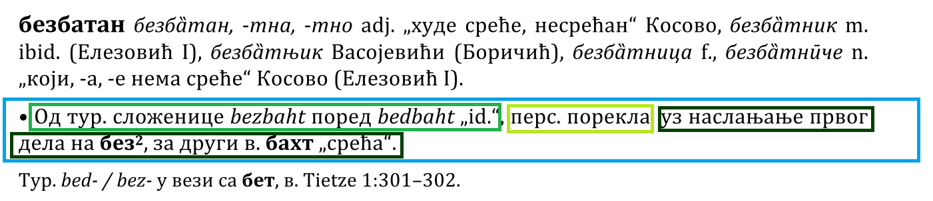
Starting point

Slide 3
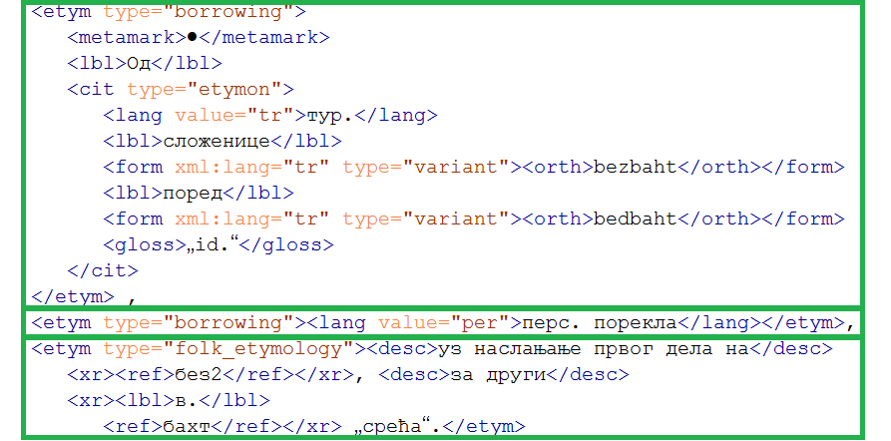
The <etym> tag Episode 1 – sequential?

Slide 4
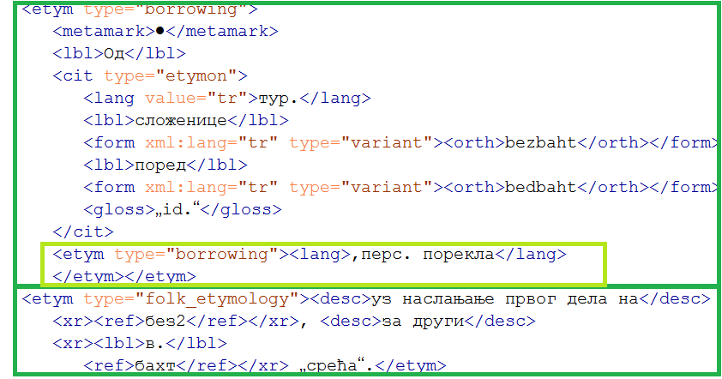
The <etym> tag Episode 2 – nested?

Slide 5
To be continued… Thank you!

